Slide 1
CHAPTER 18 – GET WITH THE PROGRAM

Slide 2
OVERVIEW: PROGRAMMING CONCEPTS
Programming
  Act of formulating an algorithm or program
Basic concepts have been developed
  Over last 50 years
  Simplify common programming tasks
Concepts will be expressed in JavaScript

Slide 3
PROGRAMMING CONCEPTS
Names, values, variables
Declarations
Data types, numbers, string literals and Booleans
Assignment
Expressions
Conditionals

Slide 4
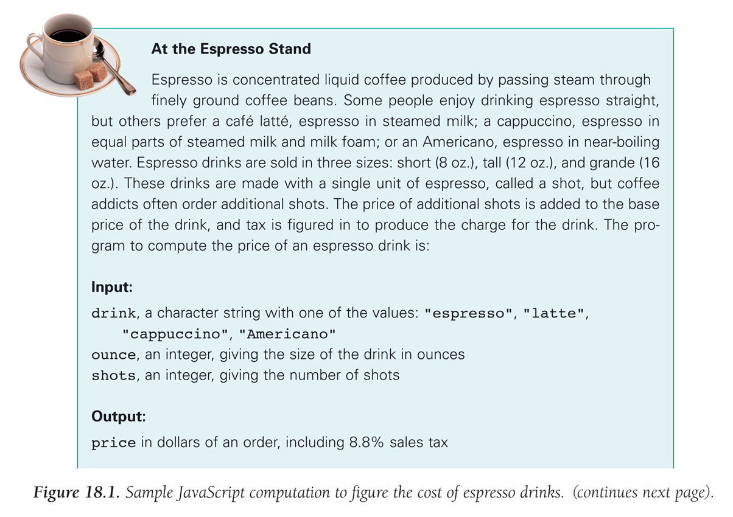
18-<number>

Slide 5
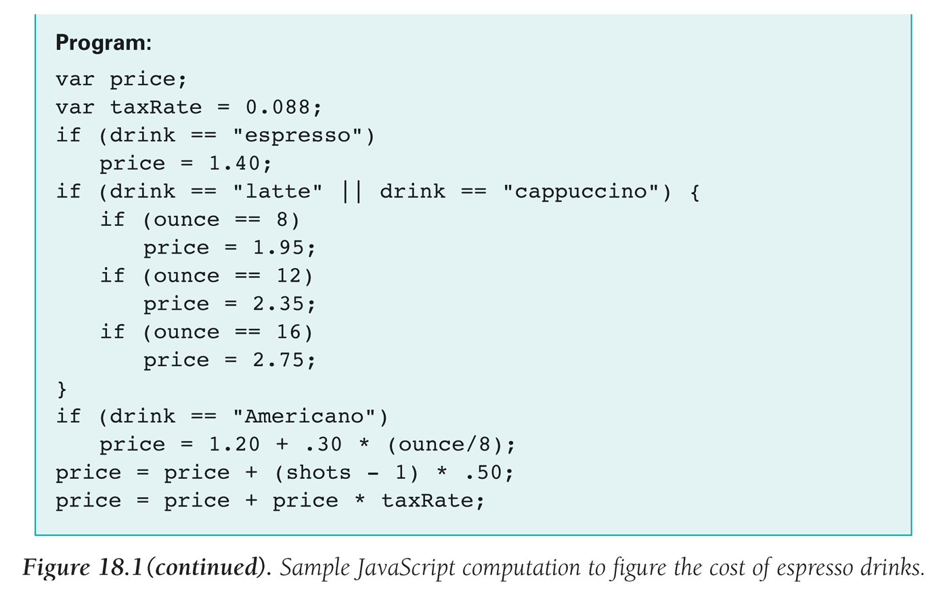

Slide 6
NAMES, VALUES, AND VARIABLES
Names Have Changing Values
  Example
    U.S. President has current value of Bracak Obama
    Previous values of George W. Bush, Bill Clinton, George Washington
Names in a Program Are Called Variables
  Values associated with a name change in programs using the assignment statement ( = )

Slide 7
IDENTIFIERS &THEIR RULES
Identifier is the character sequence that makes up a variable's name
  Must have a particular form
    Must begin with a letter or underscore ( _ ) followed by any sequence of letters, digits, or underscore characters
    Cannot contain spaces
    Case sensitive (Capitalization matters!)

Slide 8
VALID OR NOT VALID?
firstOne
first-1
first$1
First One
First_One
FirstOne
Valid
Invalid
Invalid
Invalid
Valid
Valid

Slide 9
A VARIABLE DECLARATION STATEMENT
Declaration
  State what variables will be used
    Before a variable can be used it must be declared
  Command is the word var
  For example, a program to calculate area of circle given radius, needs variables area and radius:
    var radius, area;
The declaration is a type of programming statement

Slide 10
THE STATEMENT TERMINATOR
A program is a list of statements
The statements may be run together on a line
Each statement is terminated by the statement terminator symbol
  In JavaScript, it is the semicolon ( ; )

Slide 11
HOW TO DECLARE A VARIABLE
We must declare a variable before we can use it
Generally, do this at the beginning of a program
  In JavaScript can be done anywhere
Two basic types of variable declaration
  Undefined = no value is assigned during declaration
  Initialized Value = value is assigned during declaration

Slide 12
EXAMPLE
Undefined
Initial Value
var num1;
var num2, num3;
var balance_due;
var num2 = 124;
var taxRate = .088;
var height = 5.4, hairColor = “Brown”;

Slide 13
THREE BASIC DATA TYPES OF JAVASCRIPT
Numbers
Strings
Booleans

Slide 14
NUMBERS
Rules for Writing Numbers
  There are no "units" or commas
  Can have about 10 significant digits and can range from 10⁻³²⁴ to 10³⁰⁸

Slide 15
STRINGS
Strings are sequences of keyboard characters
Strings are always surrounded by single ( ' ' ) or double quotes ( " " )
Strings can initialize a declaration
  var hairColor = "black";

Slide 16
RULES FOR WRITING STRINGS IN JAVASCRIPT
Must be surrounded by single or double quotes
Allow most characters except return (Enter), backspace, tab, \
Double quoted strings can contain single quoted strings and vice versa
The apostrophe ( ' ) is the same as the single quote
Any number of characters allowed in a string
Minimum number of characters is zero ( "" ), which is the empty (a.k.a. null) string

Slide 17
LITERALS
String literals stored in the computer
  Quotes are removed (they are only used to delimit the string literal)
  Any character can be stored in memory
    Even a character that cannot be typed can be stored, using escape mechanism – in JavaScript, the backslash ( \ )

Slide 18
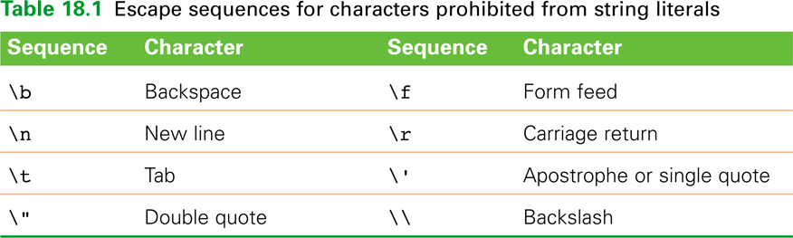

Slide 19
BOOLEAN VALUES
Two logical values
  True and False
They are values, not identifiers or strings
Used implicitly throughout programming process; only occasionally for initializing variables
  Mostly used to compare data or make decisions

Slide 20
THE ASSIGNMENT STATEMENT
Changes a variable's value
  <variable> <assignment symbol> <expression>;
Assignment Symbol
  In JavaScript, the equal sign ( = )
  Example:
    weeks = days / 7;

Slide 21
Value flows from the right side to the left side
Read the assignment symbol as "is assigned" or "becomes" or "gets"
The expression (right side) is computed or evaluated first
  If there are any variables in it, their current value is used
Then this computed value becomes the value of the variable on the left side

Slide 22
THREE KEY POINTS ABOUT ASSIGNMENT
All three of the components must be given
  If anything is missing, the statement
  is meaningless
Flow of value to name is always right to left
Values of any variables used in the expression are always their values before the start of the execution of the assignment

Slide 23
AN EXPRESSION AND ITS SYNTAX
Algebra-like formula called an expression
  Describe the means of performing the actual computation
  Built out of values (a.k.a. operands) and operators
    Standard arithmetic operators are symbols of basic arithmetic
2 + 6
operand operator operand

Slide 24
ARITHMETIC OPERATORS
Types of Operators
  Binary = has two operands (like + and - )
  Unary = has one operand ( - for negate)
Multiplication Symbol
  *
Multiply and divide are performed before add and subtract
  Unless grouped by parentheses
N/G on exponents

Slide 25
Modulus or mod ( % )
  Divides two integers and returns the remainder
  Examples:
    4 % 2 = 0
    5 % 2 = 1

Slide 26
EXAMPLES
If we have the following declarations…
var a = 6, b = 4, c = 5;
var height = 5.4, width = 6.6;
var pi = 3.14, diameter = 9;
var days = 3, hours = 14, minutes = 45, seconds = 10;
var totalScore = 10, shotclock = 15;
What would be the value of…
a * (b + c)
height * width / 2
pi * diameter
(((days * 24) + hours) * 60 + minutes) * 60 + seconds
totalScore = totalScore + 10
shotclock = shotclock – 1
= 54
= 17.82
= 28.26
= 312310
= 20
= 14

Slide 27
RELATIONAL OPERATORS
Make comparisons between numeric values
  Outcome is a Boolean value (true or false)
< less than
<= less than or equal to
== equal to
!= not equal to
>= greater than or equal to
> greater than

Slide 28
EXAMPLES
If we have the following declarations…
var a = 6, b = 4, c = 5;
var bondrate = .054, cdrate = .036;
var age = 67, temperature = 100;
What would be the value of…
a == b
b >= 3
c != 10
bondrate <= cdrate
temperature > 212
age < 65
false
true
true
true
false
false

Slide 29
LOGICAL OPERATORS
To test 2 or more relationships as 1
Logical And
  Operator is &&
  Outcome of a && b is true if both a and b are true; otherwise it is false
Logical Or
  Operator is ||
  Outcome of a || b is true if either a is true or b is true

Slide 30
Logical Not
  Operator is !
  Unary operator. Outcome is opposite of value of operand

Slide 31
EXAMPLES
If we have the following declarations…
var a = 6, b = 4, c = 5;
var bondrate = .054, cdrate = .036;
var age = 16, temperature = 100;
What would be the value of…
age > 12 && age < 20
age == 16 || age == 17
! (age > 12 && age < 20)
true
true
false

Slide 32
OPERATORS (CONT'D)
Operator Overload
  Use of an operator with different data types
  Case of interest in JavaScript is +
Addition
  When used with numbers, it adds
    4 + 5 produces 9
Concatenation
  When + is used with strings, it concatenates or joins the strings together
    "four" + "five" produces "fourfive"

Slide 33
A CONDITIONAL STATEMENT
A conditional statement is used to aid testing operands.
if ( <Boolean expression> )
<then-statement>;
Boolean expression is a relational expression
then-statement is any JavaScript statement

Slide 34
EXAMPLES
If we have the following declarations and statements…
var waterState;
var waterTemp = 15;
if (waterTemp < 32)
waterState = “frozen”;
var waterState;
var waterTemp = 78;
if (waterTemp < 32)
waterState = “frozen”;
waterState will contain…
waterState will conain…
frozen
“”

Slide 35
COMPOUND STATEMENTS
Sometimes we need to perform more than one statement on a true outcome of the predicate test
You can have a sequence of statements in the then clause
Group these statements using curly braces {}
  They are collected as a compound statement

Slide 36
EXAMPLES
If we have the following declarations and statements…
var waterState;
var waterTemp = 15;
var descrip;
if (waterTemp < 32)
{
waterState = “frozen”;
descrip = “ice”;
}
var waterState;
var waterTemp = 15;
var descrip;
if (waterTemp < 32)
{
waterState = “frozen”;
descrip = “ice”;
}
waterState will contain:
waterState will contain:
frozen
“”
and descrip will contain:
and descrip will contain:
ice
“”

Slide 37
IF/ELSE STATEMENTS
Allows statements to be performed if the predicate is true OR false

Slide 38
if ( <Boolean expression> )
{
<then-statements>;
}
else
{
<else-statements>;
}
The Boolean expression is evaluated first
  If the outcome is true, the then-statements are executed and the else-statements are skipped
  If the outcome is false, the then-statements are skipped and the else-statements are executed

Slide 39
NESTED IF/ELSE STATEMENTS
The then-statement and the else-statement can contain an if/else
The else is associated with the immediately preceding if
Correct use of curly braces ensures that the else matches with its if

Slide 40
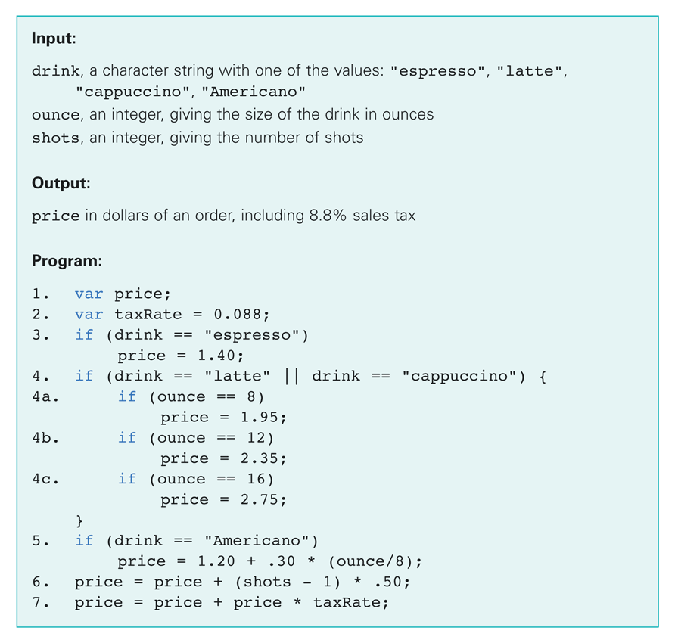

Slide 41
THE ESPRESSO PROGRAM
Line 3 is a basic conditional statement
Lines 4-4c use an if statement with conditionals in the then statement
Line 5 uses basic if statement
Lines 6, 7 compute using arithmetic operators

Slide 42
WEDNESDAY’S LAB
Part 3 – Your Very Own JavaScript
Create a web page that will help compute a Student’s bill at CSI. Your page should have two prompts, asking for a name of the student and the number of credits he/she plans to take this semester.
In addition, prompt the user for their year (freshman, sophomore, junior, or senior).
Student fees are as follows:
Freshman $50
Sophomore $75
Junior and Seniors $100

Slide 43
An alert box should welcome the student and state the amount to be paid, according to the student fee and the credit price discussed below.
The price per credit is $360 dollars.
Note: If a student takes more than 12 credits, the additional credits (more than 12) are free.
www.cs.csi.cuny.edu/~zelikovi/csc115/SimpleJavaScriptPrompt.html

Slide 44
//here is our program

